Slide 1

Entertainer Analysis
By Manisha Neware

Slide 2
Agenda
INTRODUCTION
DATASETS
CODING PART
PRIMARY GOALS
MY DESIGNS

Slide 3
introduction
Analyzing the Entertainer dataset offers us a unique opportunity to unearth hidden insights and unlock the secrets of e greatest entertainer greatest achievements. Beyond the exhilarating moments on the pitch lies a treasure trove of information that can provide us with invaluable perspectives on award won, hardship, career breakthrough, and the ever-evolving landscape of their beautiful journet.

Slide 4
Datasets:-
Entertainer – Basic Info
Entertainer – Breakthrough Info
Entertainer – Last Work Info
We have studied all of the three dataset and looked for if there any missing value
After that merged all of the three data using python pandas libraries using concatenate method.
Though concatenated data was not enough for the dashboard so downloaded data from IMDB dataset

Slide 5
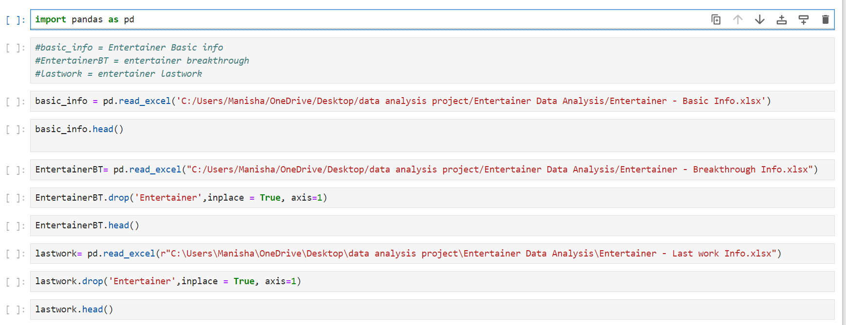
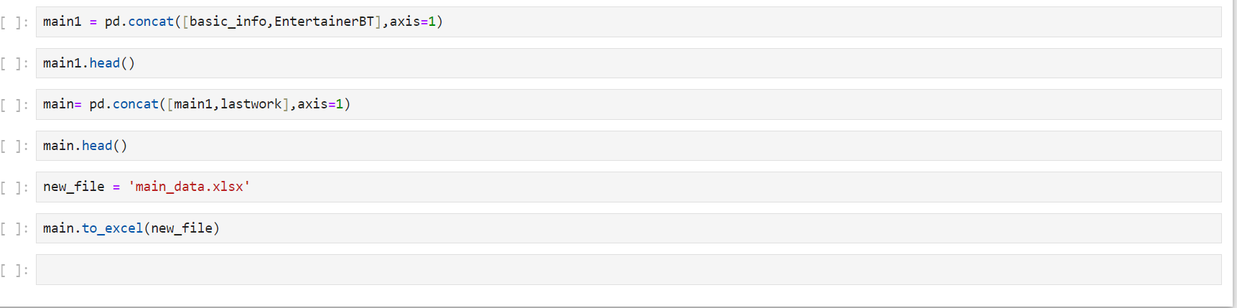
Coding part

Slide 6
Primary goals
we'll navigate through decades of Grammy Won, Emmy Won, Oscar won, and breakthrough year, unraveling the stories that have shaped the course of entertainment history.

Slide 7
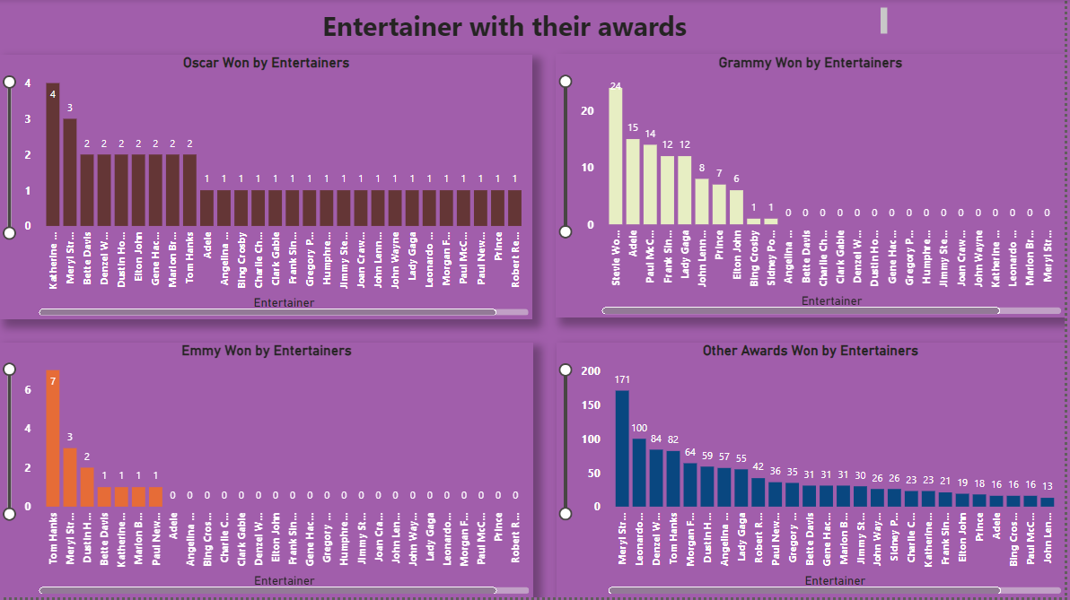
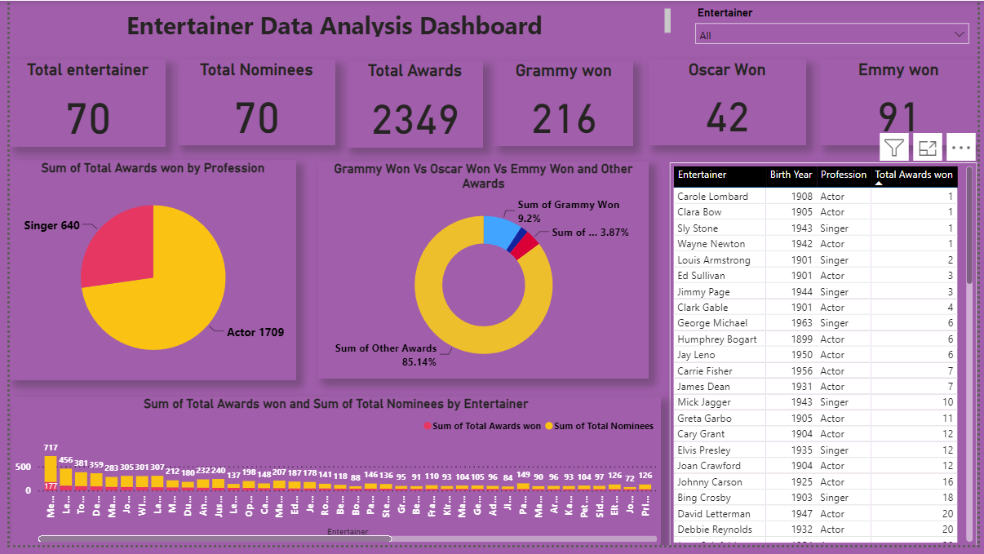
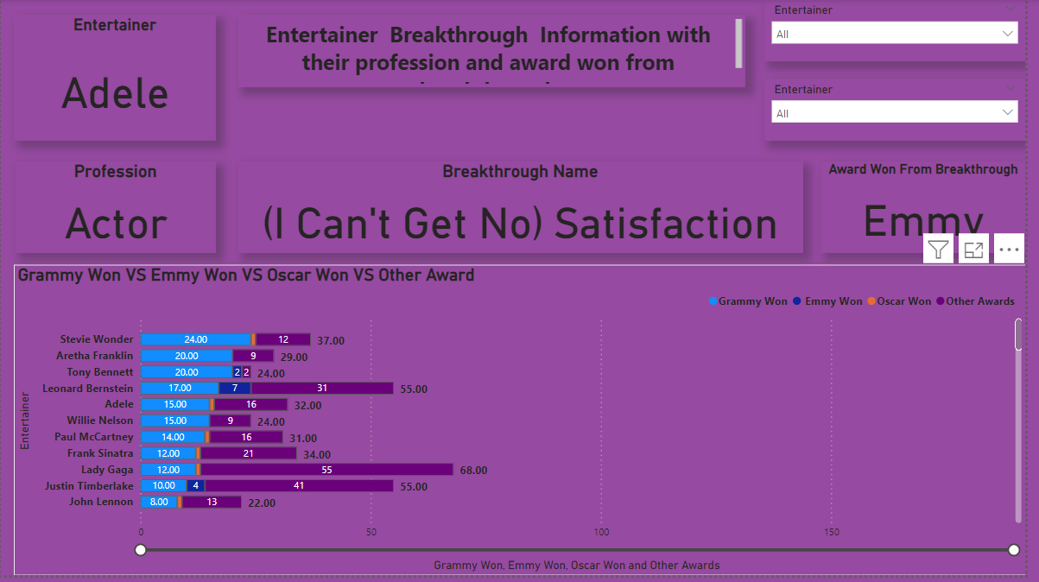
My designs

Slide 8
Thank you
Manisha Neware
manishaneware221@gmail.com

